Slide 1
Radio and the Road Ahead:
How radio road trips can help brands to tap into returning consumer confidence and drive sales

Slide 2
Since restrictions began in 2020, more than a third of CR listeners have consistently tuned in for longer
% Consuming more radio during recent lockdown vs pre-pandemic
April 2020
August 2020
November 2020
April/May 2021
CRL: 38%
Additional 1 hour 49 mins /day
CRL: 36%
Additional 1 hour 34 mins/day
CRL: 34%
Additional
1 hour 53 mins /day
Commercial Radio Listeners who are listening more are tuning in for an additional:
1 hour 38 minutes/day
Source: DRG/Radiocentre 2021

Slide 3
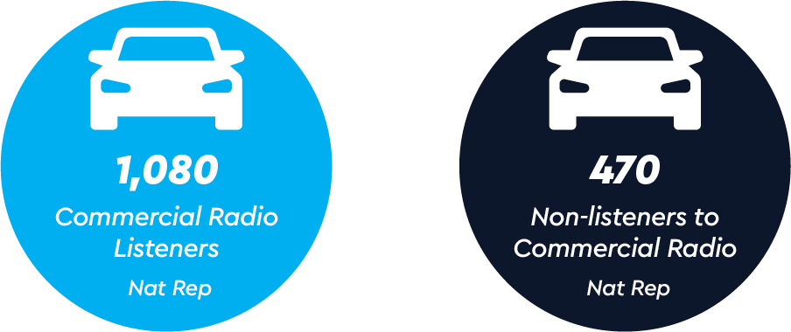
About this study
Conducted by DRG
Total sample: 1550 adults (16+ split/matched nat rep),
Fieldwork dates: 23rd -29th April
Source: DRG/Radiocentre 2021

Slide 4
The return of the confident consumer…

Slide 5
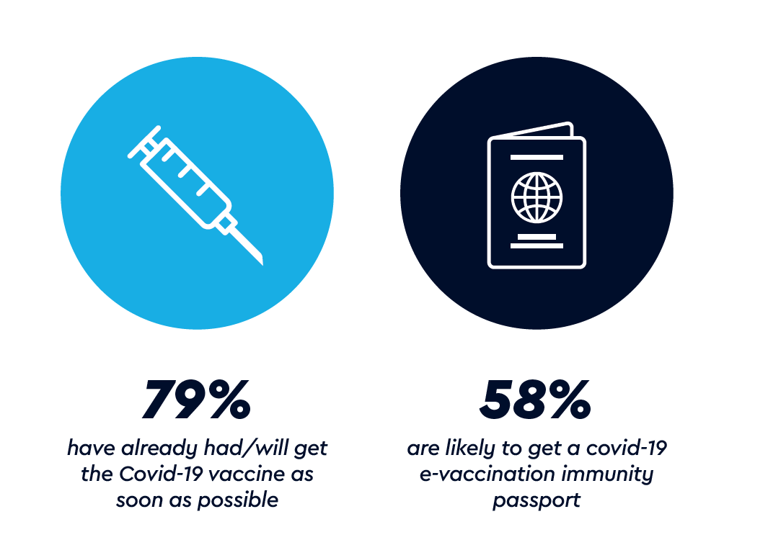
Most people have already been/are planning to get vaccinated
Total Sample: % agree/strongly agree with each statement
Source: DRG/Radiocentre 2021

Slide 6
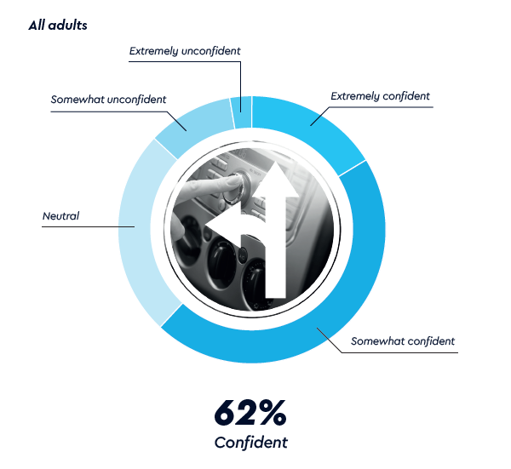
Confidence is high that pre-covid activities will resume soon
Total Sample - % Confidence levels in resuming pre-covid activities as vaccination numbers grow
Source: DRG/Radiocentre 2021

Slide 7
The spending intentions of the confident consumer

Slide 8
Spending is likely to return rapidly…
“As restrictions lift, people are expected to return to spending and socialising.”
Andy Haldane Chief Economist at the Bank of England (Feb 2021)
Two Reasons:
1. Household finances
2. Household psychology

Slide 9
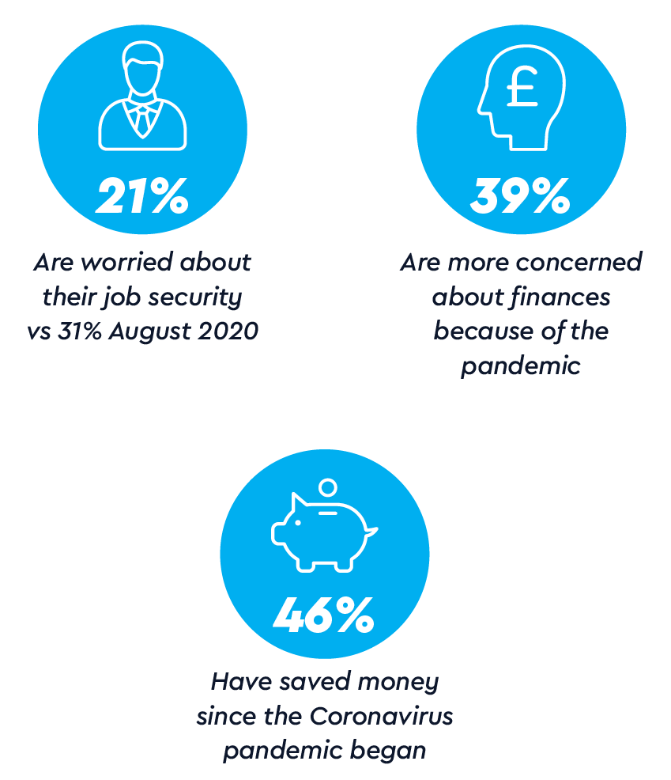
Many have saved money during the pandemic
Total Sample - % agree/strongly agree with each statement
Source: DRG/Radiocentre 2021

Slide 10
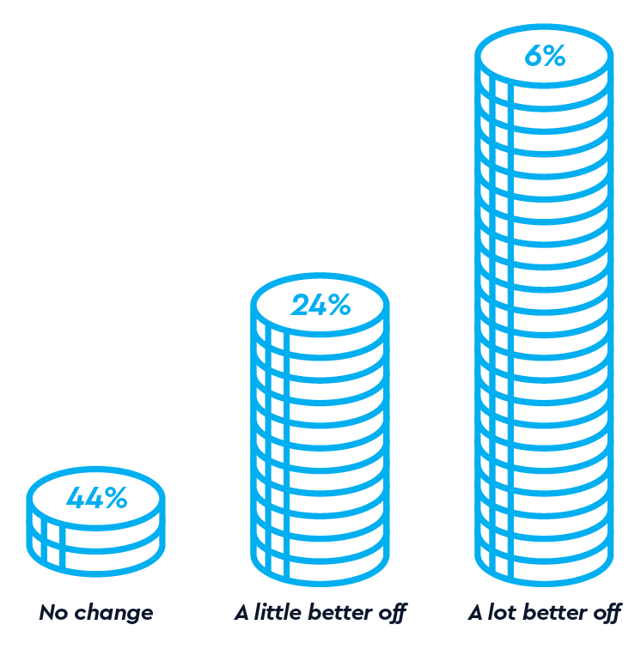
Around three-quarters feel that their personal finances are as good as, or better than, the same time last year
Total Sample - % feel financially better off/no change compared to last year
74%
Source: DRG/Radiocentre 2021

Slide 11
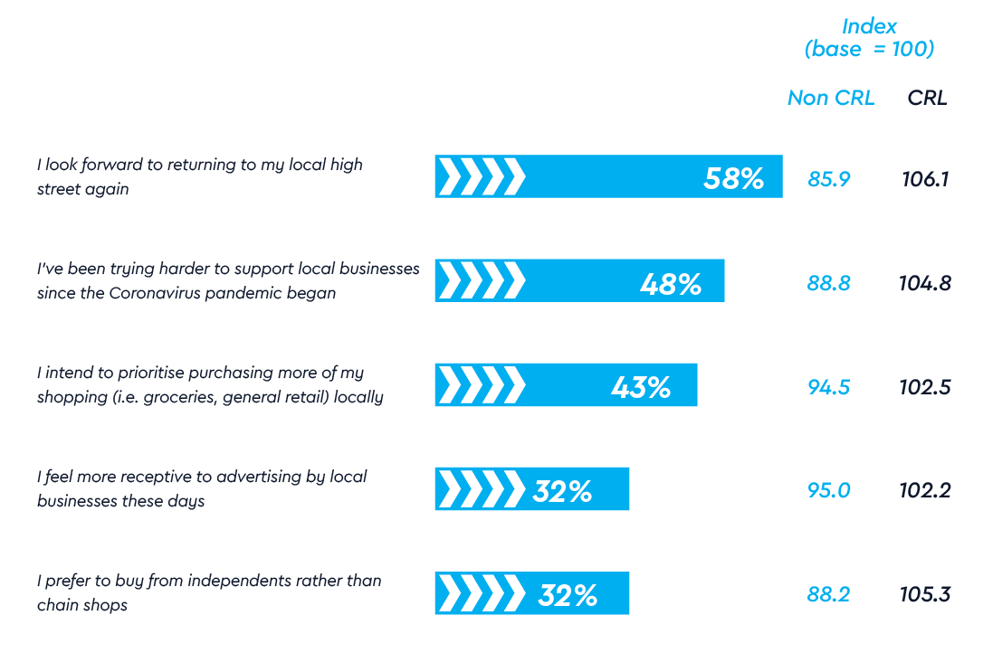
There is a desire, especially among commercial radio listeners, to support local businesses
Source: DRG/Radiocentre 2021

Slide 12
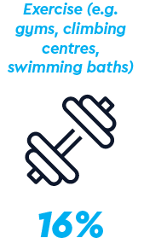
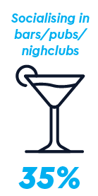
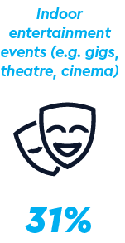
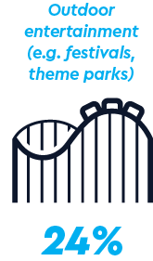
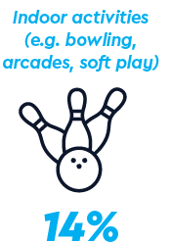
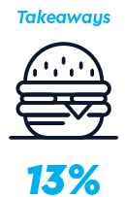
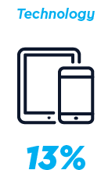
People are looking forward to spending money again; notably on socialising and travel
Leisure & Entertainment
Fashion, Beauty & Well-being
Travel
Home & Tech
Source: DRG/Radiocentre 2021

Slide 13
Commercial Radio Listeners are 62% more likely to purchase a car in the near future
% planning to do each following lockdown relaxation
Purchase/lease a petrol/diesel car
Purchase/lease a hybrid car
Purchase/lease a fully electric car
CRL: 11.7%
(index 177)
CRL: 6.7%
(index 268)
CRL: 4.7%
(index 181)
Non CRL 6.6%
Non CRL 2.5%
Non CRL 3.6%
Source: DRG/Radiocentre 2021

Slide 14
2021: the summer of the car journey

Slide 15
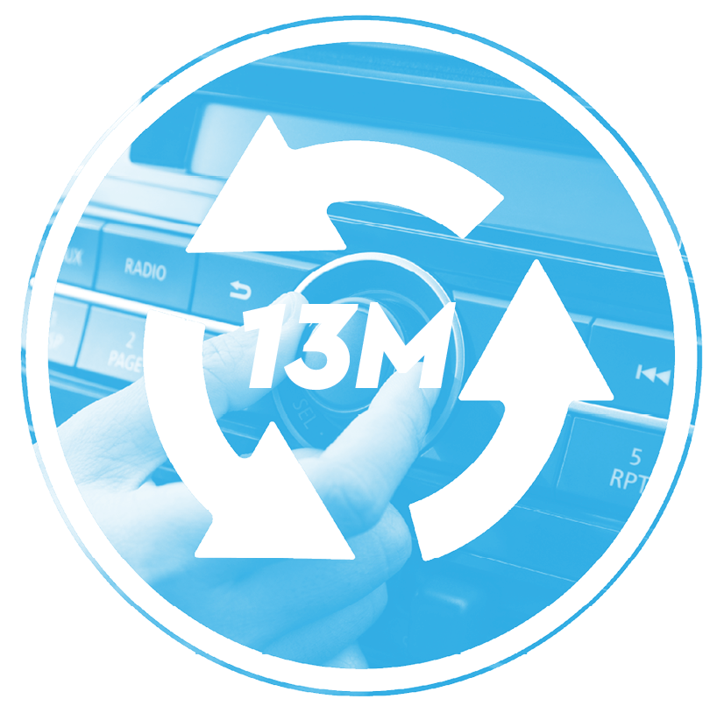
As car journeys set to surge, Commercial Radio delivers access to consumers beyond other media
13M Commercial radio listeners tune in daily in their car
Source: IPA Touchpoints

Slide 16
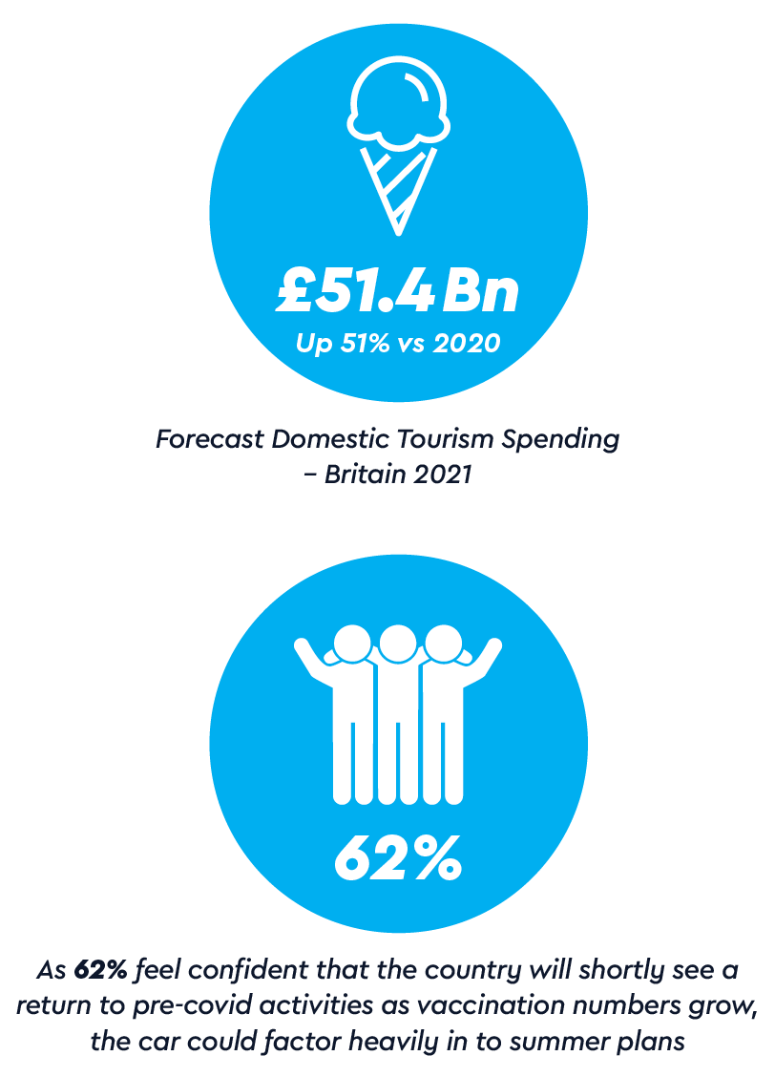
With high optimist around a return to pre-covid activities, the car will help consumers with their summer plans
The signs point towards a summer of enjoying all that the UK has to offer
Source: DRG/Radiocentre 2021
Source: Visit Britain 2021 Tourism Forecast

Slide 17
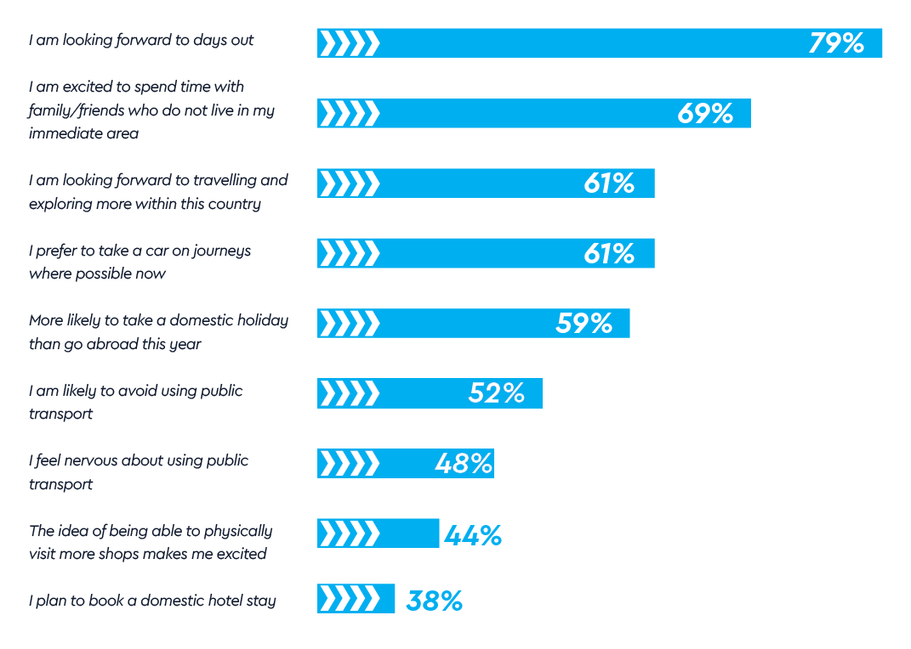
People are planning to take advantage of lockdown relaxation to see places and people within the country
Total Sample - %Agree/Strongly Agree (5 point scale)
Source: DRG/Radiocentre 2021

Slide 18
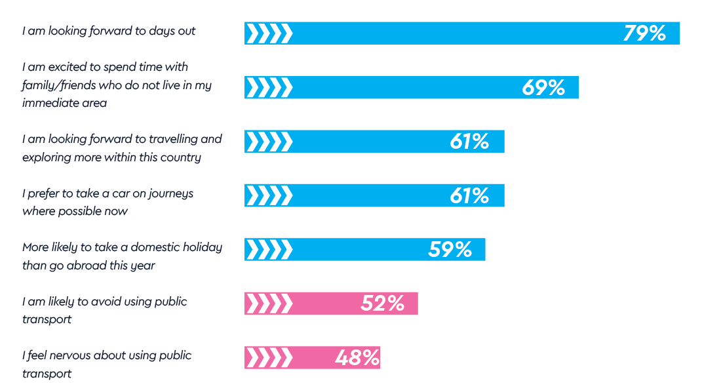
As uncertainty remains around public transport, the car will provide a strong option for travel
Total Sample - %Agree/Strongly Agree (5 point scale)
Source: DRG/Radiocentre 2021

Slide 19
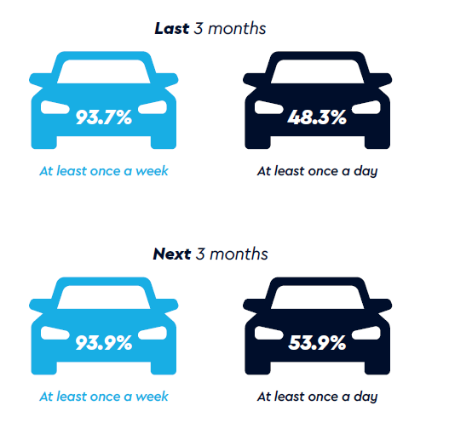
Commercial radio listeners with cars in their households anticipate that regular use will continue, with growth in daily use
Car use – Commercial radio listeners
Source: DRG/Radiocentre 2021

Slide 20
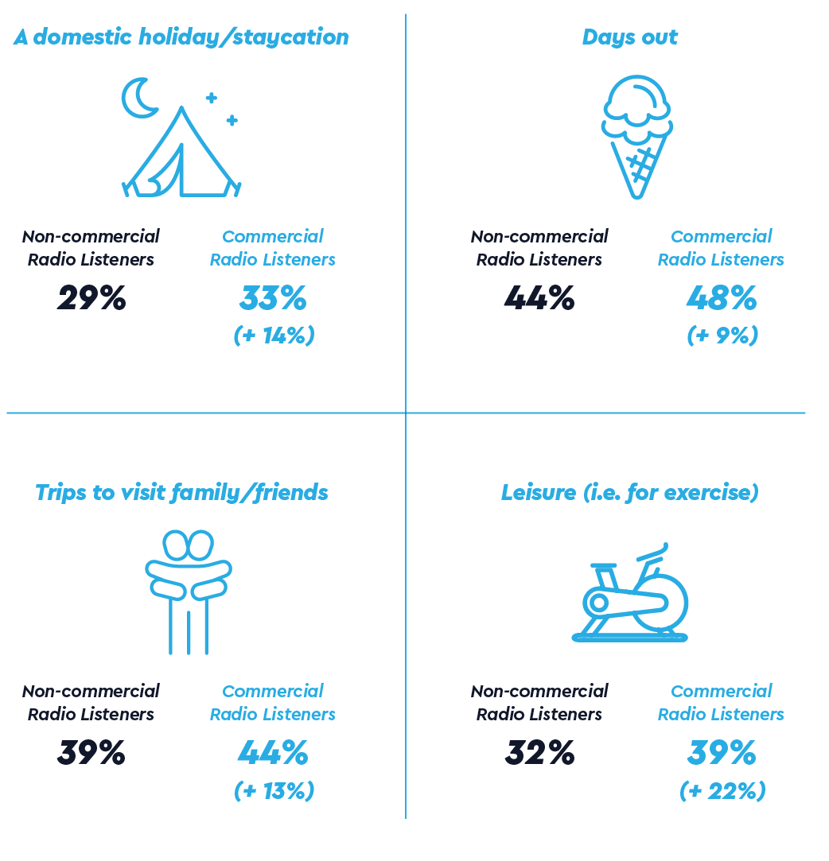
Commercial radio listeners with cars in their households anticipate that regular use will continue, with growth in daily use
% who believe they will use a car more for TRAVEL RELATED activities in the next 3 months vs past 3 months
Source: DRG/Radiocentre 2021

Slide 21
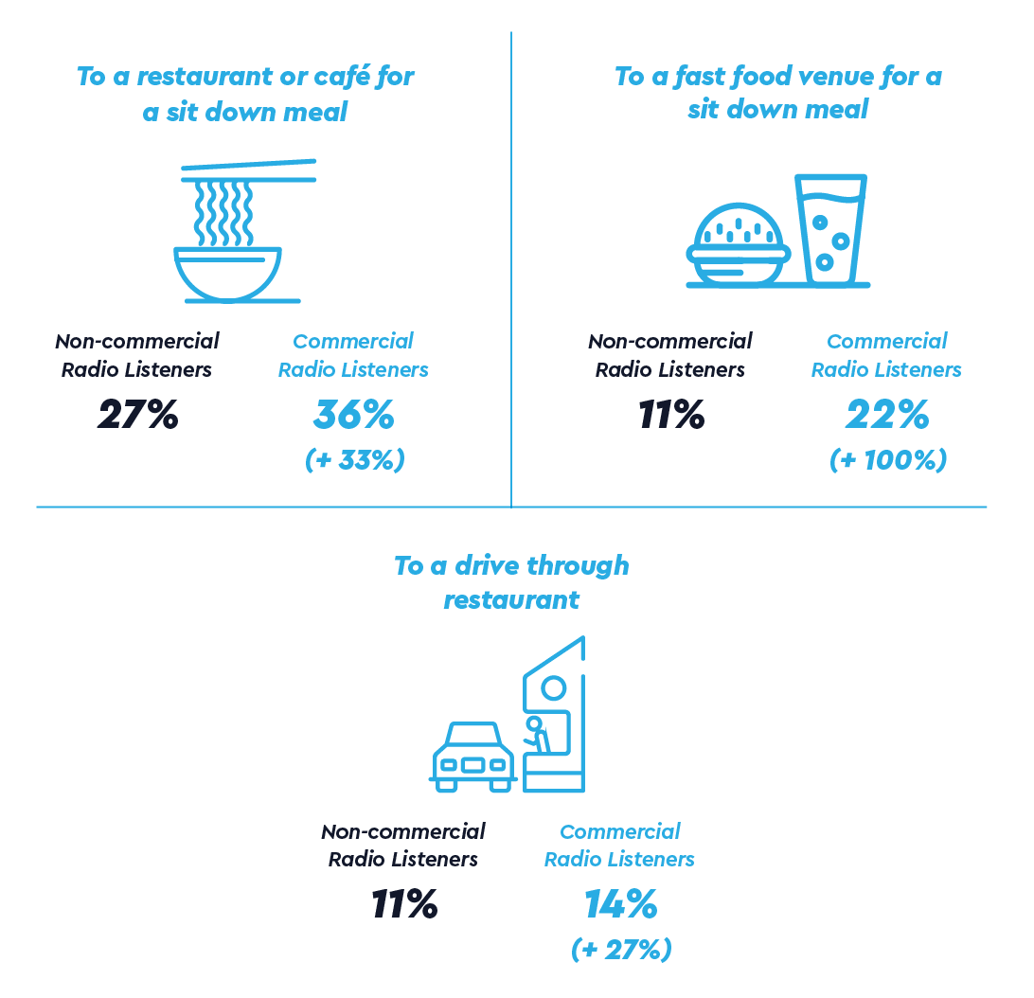
Commercial radio listeners will continue to drive for dining purposes
% who believe they will use a car more for DINING purposes in the next 3 months vs past 3 months
Source: DRG/Radiocentre 2021

Slide 22
34% of Commercial radio listeners will use their cars more for non-grocery retail in the next 3 months
Non-grocery retail
Non-commercial Radio Listeners
Commercial Radio Listeners
27%
34%
(+26%)
Source: DRG/Radiocentre 2021

Slide 23
Using radio to connect with the confident consumer on the road ahead

Slide 24
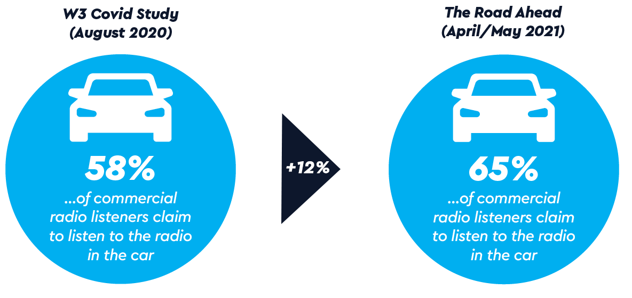
More and longer car journeys = greater availability to listen. As restrictions have relaxed, radio listening in-vehicle is increasing…
Source: DRG/Radiocentre 2021

Slide 25
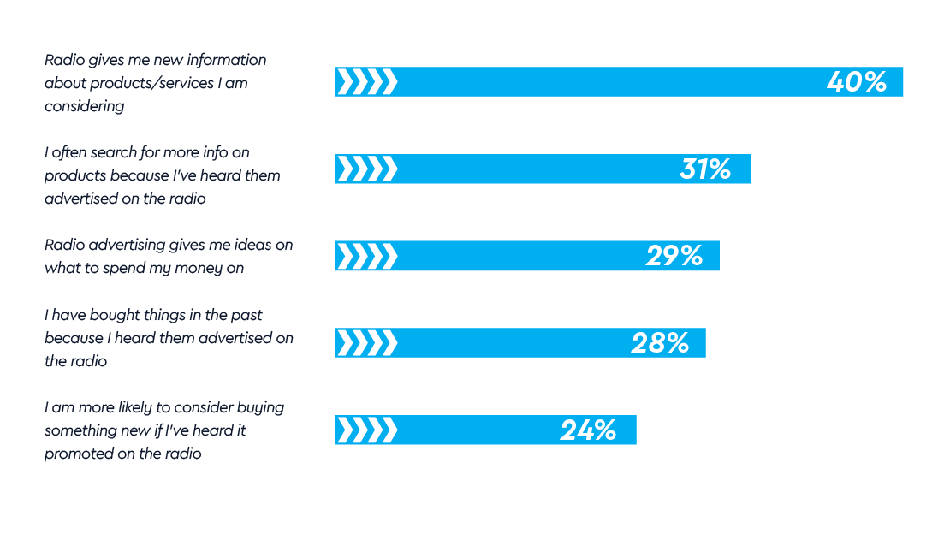
Commercial radio listeners are open to and responsive to radio advertising
Commercial radio listeners - %Agree/disagree with each statement (5 point scale)
Source: DRG/Radiocentre 2021

Slide 26
Summary
2021 is set to see a Summer of Car journeys and increased spending. Radio advertising will offer more opportunities to connect.
People are eager to get out to spend their money, enjoying days out and holidays in the UK
A strong desire remains to support local businesses and shop local
With underlying concerns remaining around public transport, the car will provide many with the easiest and safest travel option, whatever their plans.
During these frequent car journeys (for a broad range of purposes) the radio will provide a great opportunity for advertisers .
Commercial Radio Listeners tune in during car journeys and are receptive. They can be reached at a time when they in a positive mindset, heading out for enjoyable activities.
Motoring is on the minds of Commercial Radio Listeners, with many planning to make a car related purchase in the immediate future.

