Slide 1
How listeners are planning to spend as lockdown is relaxed

Slide 2
Bounce-back and beyond
With shops preparing to re-open their doors, car dealerships back in business, and some limited leisure activities available to the public, we set out to explore how COVID has influenced spending intentions in the short and long term…

Slide 3
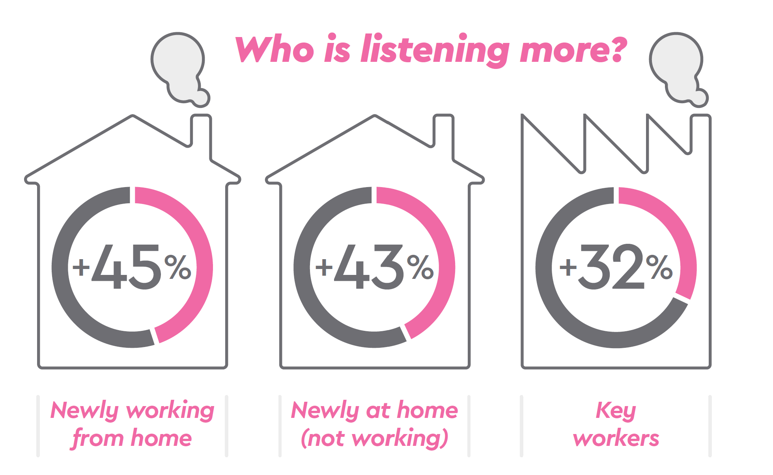
The survey
Conducted by research agency DRG
1000 commercial radio listeners took part in an online quantitative survey
We identified 3 key audience groups
Used to work primarily from an office but is now working from home
At home due to furlough or work being non-essential
Still working at employers premises due to being a designated key worker

Slide 4
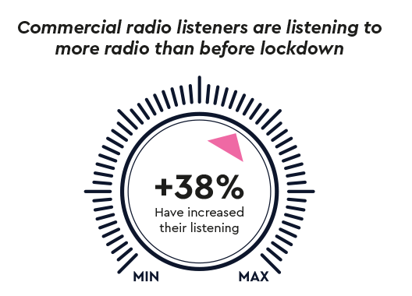
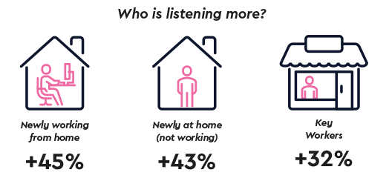
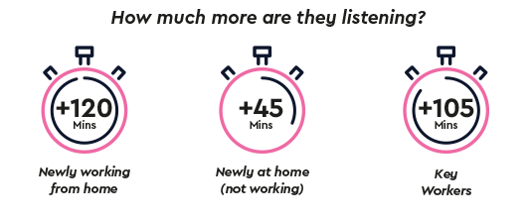
Learnings from our previous study (1)
Notes:
Radiocentre’s study Staying Connected During the COVID-19 Crisis showed that 38% of commercial radio listeners have increased their listening during lockdown. This uplift was driven largely by those newly WFH or newly at home (not working), but we saw uplifts among key workers too

Slide 5
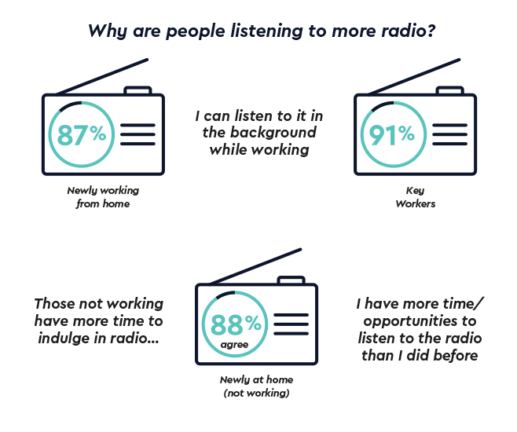
Learnings from our previous study (2)
Notes:
Radiocentre’s study Staying Connected During the COVID-19 Crisis showed that radio has an emotional role to play in people’s lives, keeping them connected even in isolation. It also serves as a trusted source of information.

Slide 6
As the UK government starts to gradually relax lockdown, how are people feeling and what do they want to spend their money on?

Slide 7
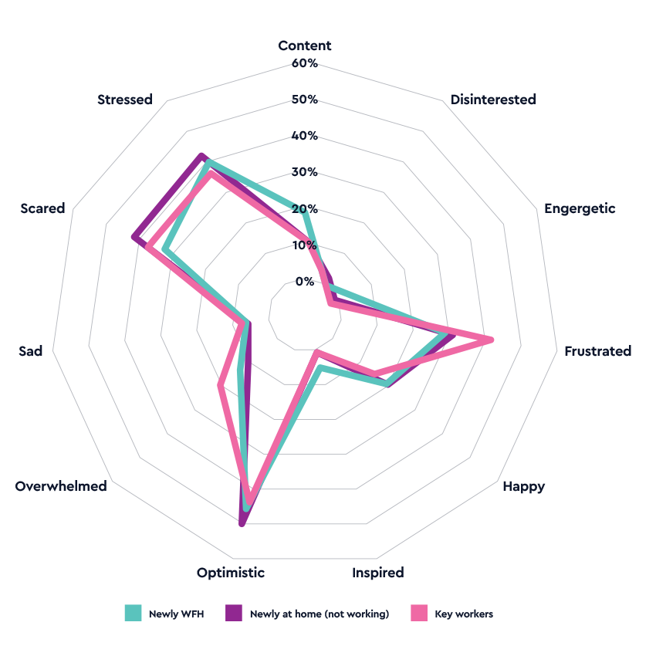
People have mixed emotions about the relaxation of lockdown
% feeling…
Q: The government will be announcing a plan for how they will relax some lockdown restrictions over the coming months and weeks, which of the following most closely matches how you feel about this? Please choose up to 3
Source: Bounce-back and beyond/DRG
Notes:
Optimism dominates emotions but this is offset by stress and concern, especially among those not working perhaps accentuated by financial problems.
Key workers also score highly for frustration, perhaps relating to the nature of their work increasing their exposure to the virus.
These mixed emotions are exerting influence on how people plan to spend money upon relaxation of lockdown.

Slide 9
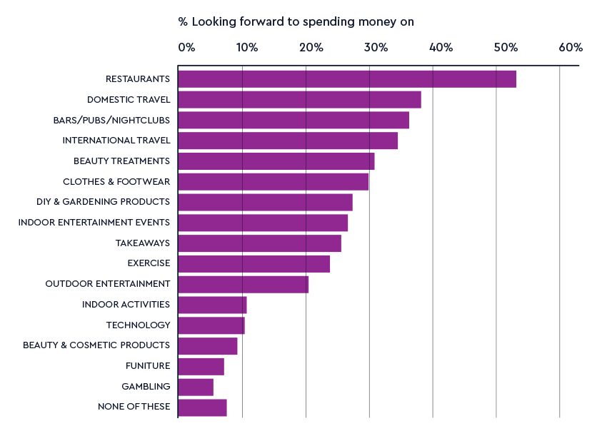
There is pent-up desire for social activities
Q: Following lockdown relaxation, many products and services that have been unavailable/difficult to find will become readily available again. Which of the following, if any, are you most looking forward to spending money on again in the immediate future?
Source: Bounce-back and beyond/DRG
Notes:
Social activities and travel top the list of things people are looking forward to spending money on – the activities that have been most impacted by the lockdown.
(Beauty treatments include hairdressing, manicures and spas. Indoor entertainment events include gigs, theatre and cinema. Exercise includes gyms, climbing centres, swimming baths. Outdoor entertainment inludes festivals, theme parks. Indoor activities include bowling, arcades and soft play. Gamblign includes bingo, casinos, betting shops.)

Slide 10
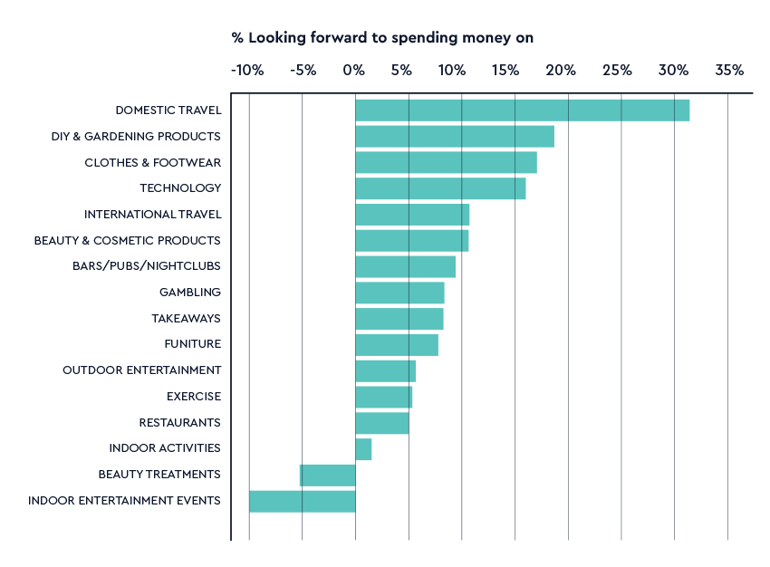
Predicted spending behaviour is more pragmatic
% intending to spend more/less money on… (net difference ‘spend more’ minus ‘spend less’)
Q: You say you are looking forward to spending money again on _. Compared to the amount you were spending before lockdown do you think you will spend more, less or about the same on _ in the immediate future?
Source: Bounce-back and beyond/DRG
Notes:
People intend to increase their spend (versus pre-lockdown) across most categories.
Despite restaurants, bars/clubs, and international travel scoring highly as categories people are excited to spend money on, the comparatively lower predicted net increase in spend, coupled with the dominance of domestic travel, suggests a more pragmatic outlook when it comes to the reality of how much they are planning to spend.

Slide 11
Different attitudes to spending driven by perceived risk and available funds
Q: You say you are looking forward to spending money again on _. Compared to the amount you were spending before lockdown do you think you will spend more, less or about the same on _ in the immediate future?
Source: Bounce-back and beyond/DRG
Notes:
Having spent so much time indoors, Newly WFH group have perhaps become partly institutionalised and are therefore more likely to increase spend on social distanced purchases and to decrease spend for social mixing purchases.
Key workers on the other hand, who have been out on the frontlines and likely less fearful of social mixing, are due to increase their spend in that area in the short term.
The Newly at home (not working) are more likely to be financially insecure, which helps to explain the more modest uplifts.

Slide 12
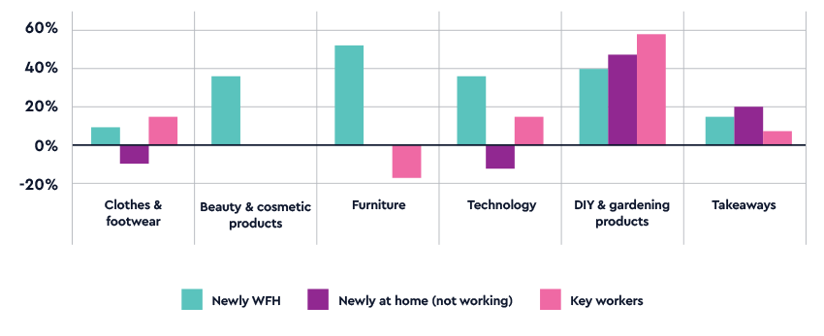
The Newly WFH planning to spend more across all social distanced purchases
Q: You say you are looking forward to spending money again on _. Compared to the amount you were spending before lockdown do you think you will spend more, less or about the same on _ in the immediate future?
Source: Bounce-back and beyond/DRG
Notes:
The Newly WFH are set to increase spend across all types of socially distanced purchase
The large increases expected in furniture and technology for this group could be due to the expectation of setting up a home office as working from home continues.
All groups expect to increase spend for DIY/Gardening – a move towards greater self sufficiency perhaps.

Slide 13
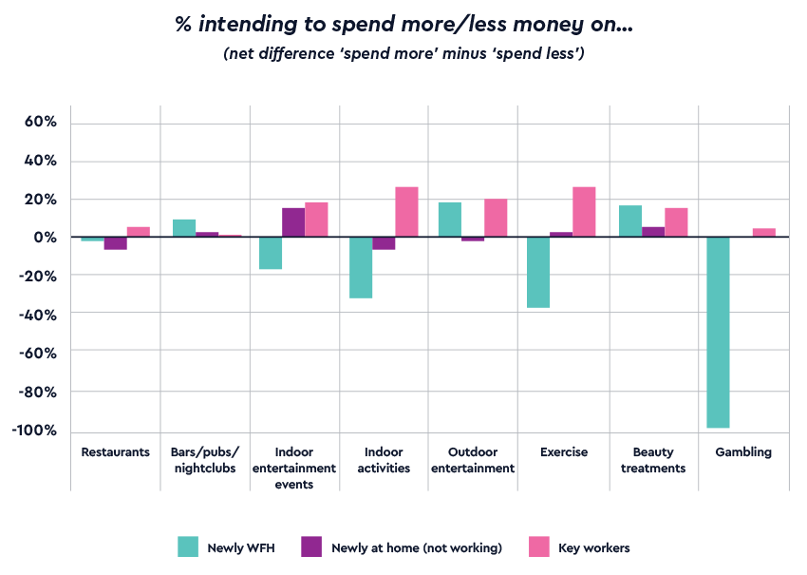
Key workers are more inclined to increase spend on social mixing activities
Q: You say you are looking forward to spending money again on _. Compared to the amount you were spending before lockdown do you think you will spend more, less or about the same on _ in the immediate future?
Source: Bounce-back and beyond/DRG
Notes:
Key workers, more psychologically immune to the risk of coronavirus as they have continued to work as normal through lockdown, are more likely to anticipate increasing spend on social mixing activities.

Slide 14
Domestic travel set to see an initial boost across all groups
Q: You say you are looking forward to spending money again on _. Compared to the amount you were spending before lockdown do you think you will spend more, less or about the same on _ in the immediate future?
Source: Bounce-back and beyond/DRG
Notes:
With non-essential travel discouraged, all groups intend to spend more money travelling within the UK.
The uplifts in international travel for Key Workers again reflects their relative confidence in living with COVID

Slide 16
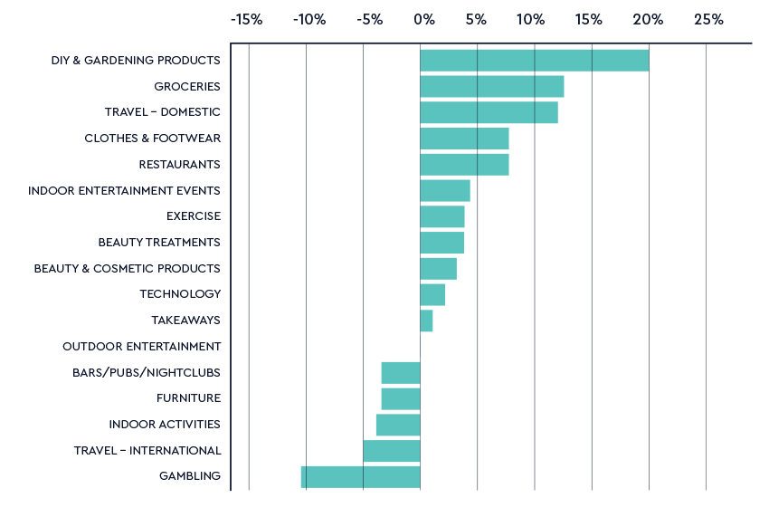
Top 3 longer-term growth categories are DIY/gardening, domestic travel, groceries
Q: Now thinking further ahead, once things return to “normal” how will the COVID-19 experience influence your spending in general in the following areas? If you didn’t spend money on this thing before please select no change
Source: Bounce-back and beyond/DRG
Notes:
Overall longer-term spending intentions are less extravagant.
The trend towards more practical, home-centred lives is reflected in spending intentions relating to DIY/gardening, groceries, and domestic travel.
This is further supported by a corollary reduction in spend for international travel and gambling.

Slide 17
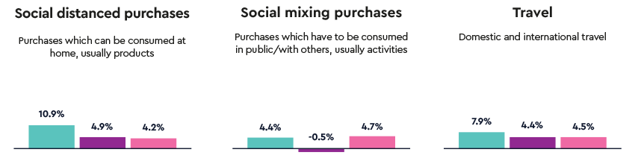
Newly WFH to increase spend the most in the longer term
Q: Now thinking further ahead, once things return to “normal” how will the COVID-19 experience influence your spending in general in the following areas? If you didn’t spend money on this thing before please select no change
Source: Bounce-back and beyond/DRG
Notes:
Longer term there is less distinction between the different audiences in terms of predicted spend
Overall increases are lower, perhaps reflecting greater uncertainty about how things will e in the longer term
Those Newly WFH are likely to increase spend most except for social mixing purchases

Slide 18
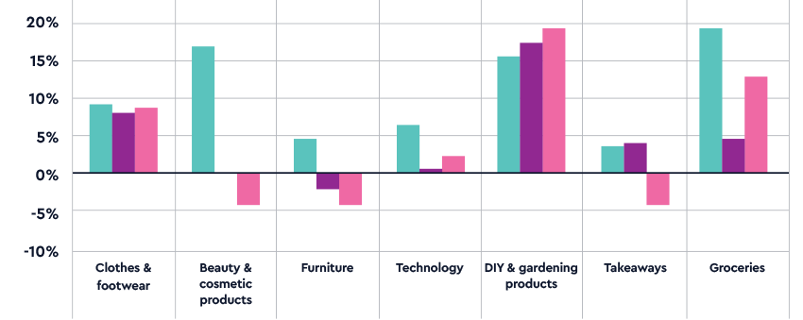
Newly WFH will continue to increase spend across all socially distanced purchases
Q: Now thinking further ahead, once things return to “normal” how will the COVID-19 experience influence your spending in general in the following areas? If you didn’t spend money on this thing before please select no change
Source: Bounce-back and beyond/DRG

Slide 19
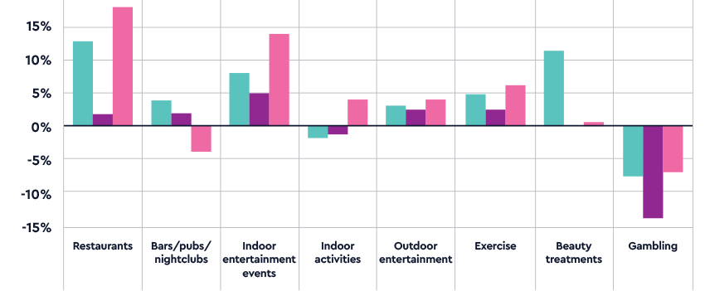
Newly WFH and key workers expect to spend more on social mixing purchases
Q: Now thinking further ahead, once things return to “normal” how will the COVID-19 experience influence your spending in general in the following areas? If you didn’t spend money on this thing before please select no change
Source: Bounce-back and beyond/DRG
Notes:
Longer term, restaurants can expect to see spend returning to the sector, with Newly WFH expect to increase spend on social mixing categories as the threat from COVID decreases. Key workers also predict increased spend on eating out and other social past-times.
Perhaps predicting greater pressure on their finances, those Newly at home (not working) are less likely to predict big spending increases in these areas.

Slide 20
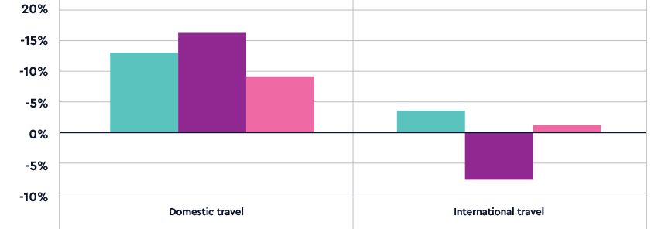
Continued boost for domestic travel long term
Q: Now thinking further ahead, once things return to “normal” how will the COVID-19 experience influence your spending in general in the following areas? If you didn’t spend money on this thing before please select no change
Source: Bounce-back and beyond/DRG
Notes:
All groups will continue to spend on domestic travel due to its lower risk and affordability.
The future looks more uncertain for international travel with the net decrease in spend among the Newly at home (not working) likely to offset any modest increases among the other groups.

Slide 21
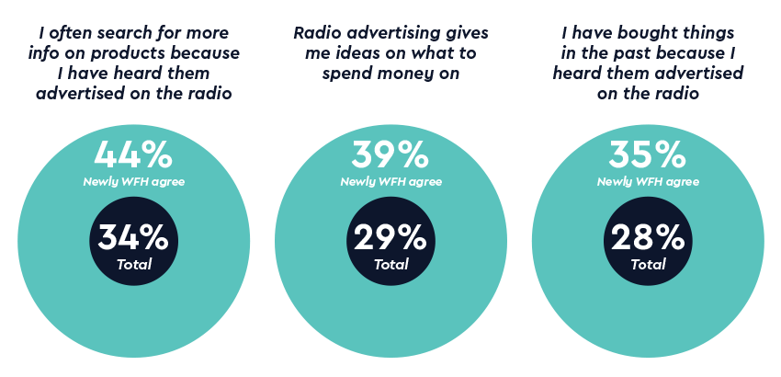
Radio plays an important role in purchase decisions, particularly the Newly WFH group
% agree
Q: Here are some things people have said about radio advertising and making decisions about what to buy. How much do you agree or disagree with each statement?
Source: Bounce-back and beyond/DRG
Notes:
As we saw in the Radiocentre study Staying Connected During the COVID-19 Crisis, the Newly WFH group have increased their radio listening the most during lockdown. This additional exposure seems to have made them even more receptive to and influenced by radio advertising than the other groups.

Slide 22
Summary 1
People feel mixed emotions about the relaxation of lockdown, with both optimism and concerns dominating feelings
There is pent-up desire to spend among commercial radio listeners across a range of categories, particularly on travel and social activities (bars and restaurants) again
This is likely to be realised in a bounce-back in spend across a number of categories, but more pragmatically distributed across socially distanced/practical activities
- DIY/gardening
- domestic travel
- clothes/footwear

Slide 23
Summary 2
After the initial bounce-back, long-term spending predictions are less extreme with a continued focus on the pragmatic, with positive indicators around social activities as COVID threat recedes
- Increase in grocery spend alongside DIY/Gardening; clothes/footwear
- Longer term future looks rosier for restaurants
- Domestic travel remains the dominant choice for the longer term
Radio has a key role to play in purchase decisions, particularly among the Newly WFH group who have increased their listening the most, meaning they have an even greater opportunity to be impacted by radio advertising.

Slide 24
Thank you

