Slide 1





Rescue
Remedy
How radio can help an advertiser’s business during the current crisis

Slide 2


Rescue Remedy
How radio can help an advertiser’s business during the current crisis
1. Benefit from increased audience availability

Slide 3

Radio helps offset feelings of isolation
Listeners feel
twice as happy
when listening to radio
Source: Radio: the Emotional Multiplier

Slide 4
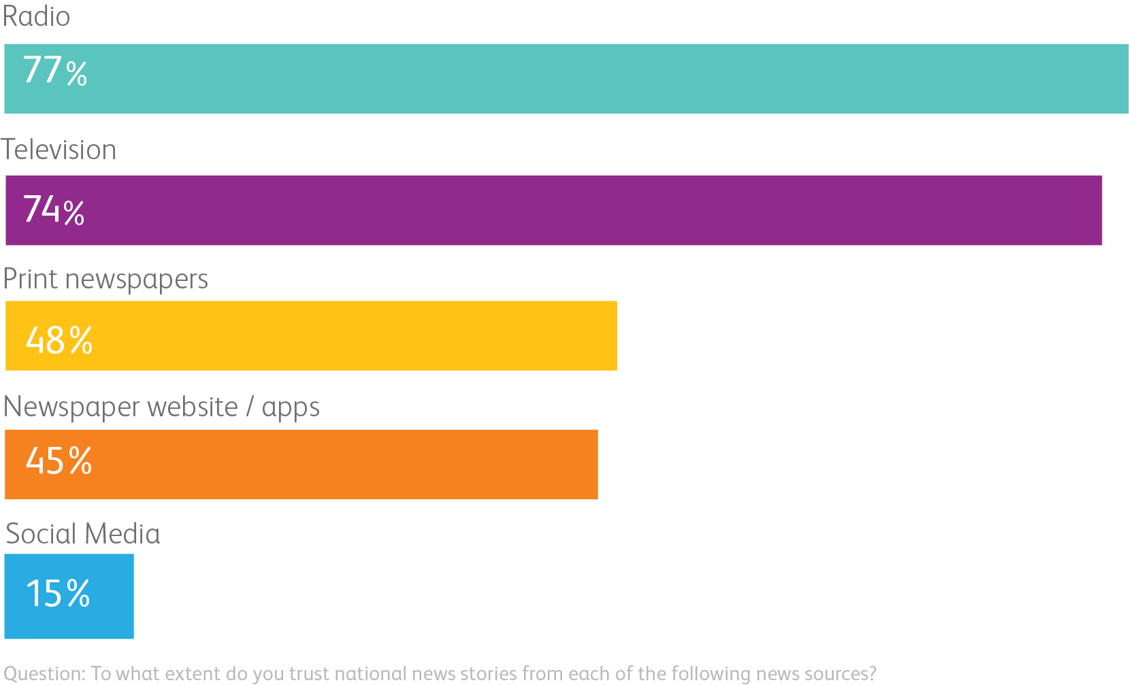
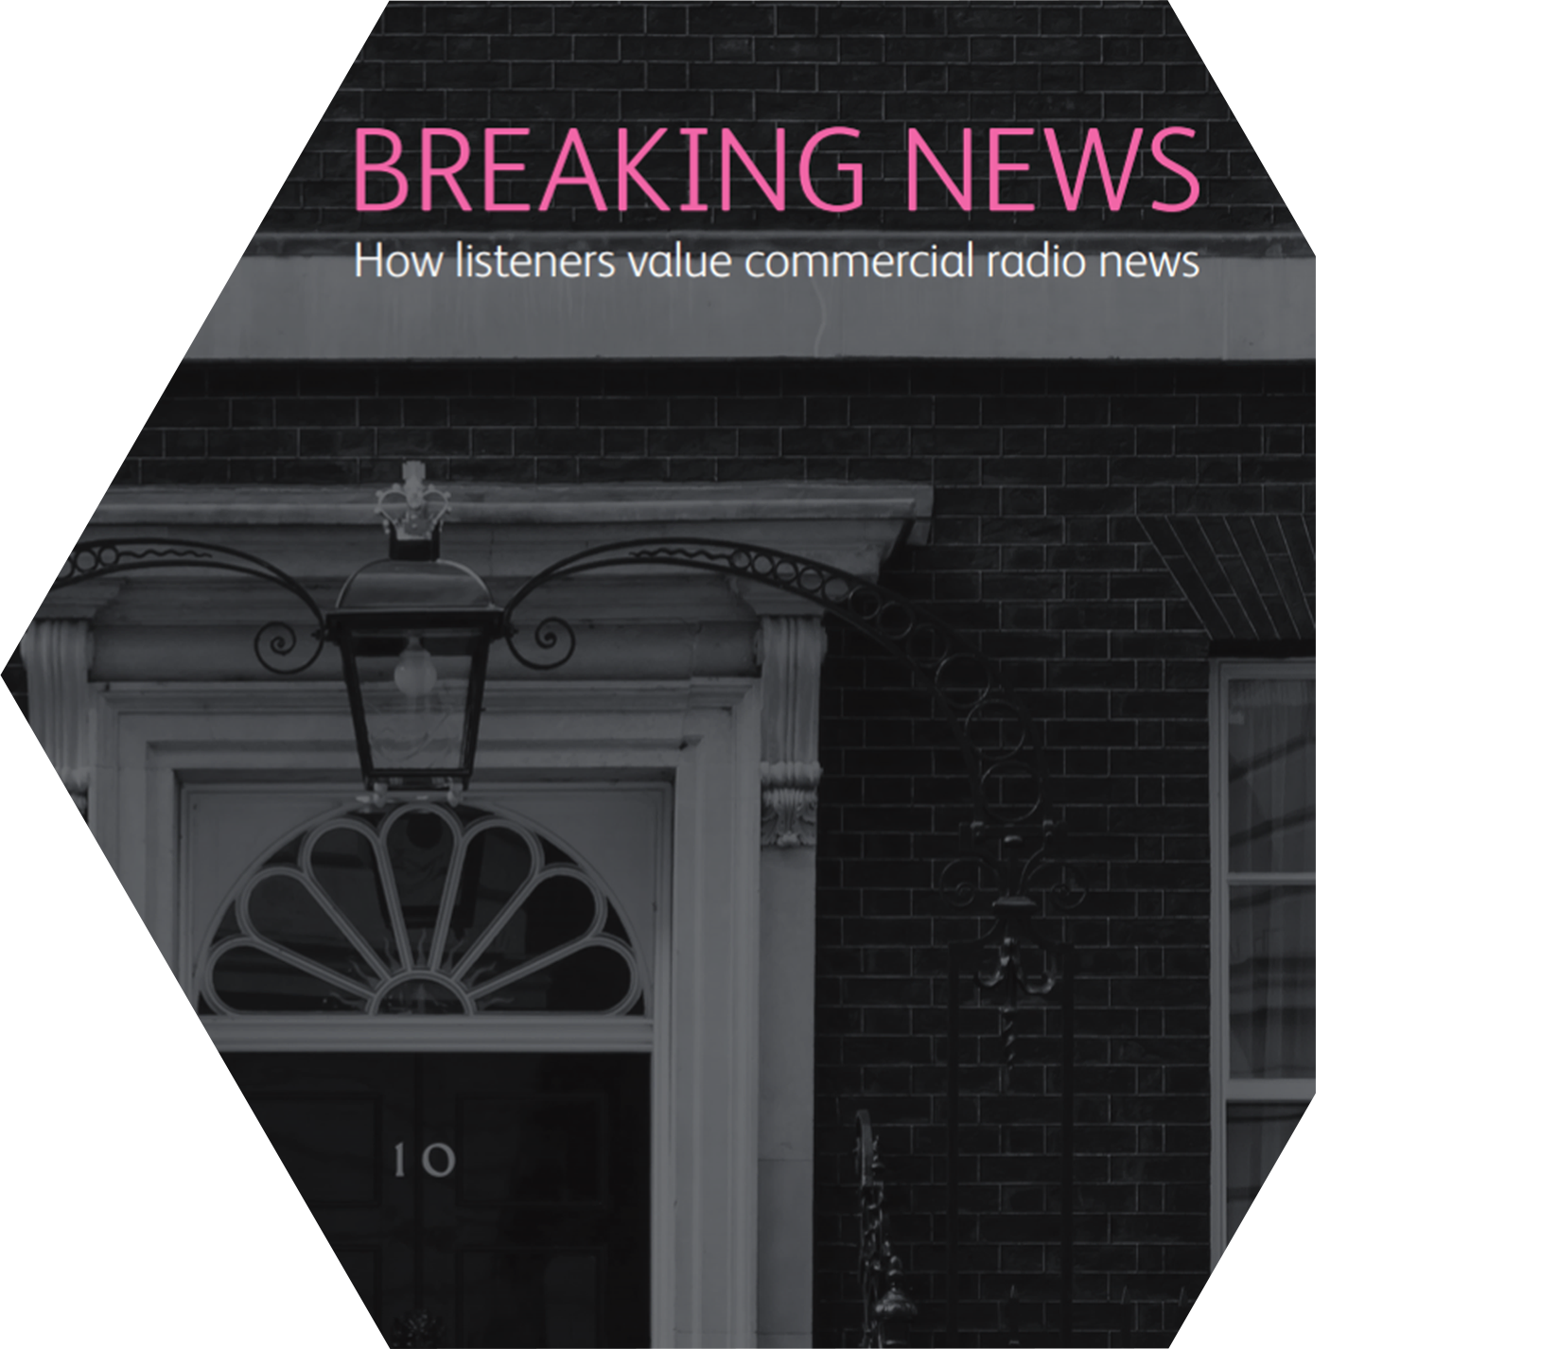
People turn to radio for trusted news
Source: Breaking News

Slide 5

Listeners absorb the detail of radio ads when engaged in other tasks

Slide 6

Ads that relate to listener activity
help turbocharge ad effectiveness

Slide 7
Rescue Remedy
How radio can help an advertiser’s business during the current crisis
1. Benefit from increased audience availability
2. Make the case for increased investment

Slide 8
Companies that increase spend are slightly less profitable during recession…
Inflation-corrected ROCE during recession (%)
Marketing spend
Source: Advertising in a recession/London Business School

Slide 9
…but increase profits much faster during recovery…
Increase in ROCE during recovery (% points)
Marketing spend
Source: Advertising in a recession/London Business School

Slide 10
…and gain market share 3x faster following the recession
Market share changes
in the first 2 years of recovery (% points)
Marketing spend
Source: Advertising in a recession/London Business School

Slide 11
Rescue Remedy
How radio can help an advertiser’s business during the current crisis
1. Benefit from increased audience availability
2. Make the case for increased investment
3. Re-evaluate the media mix

Slide 12
Radio delivers more impact(s) for your money
Ad impressions delivered by medium per £1 spend. Indexed, radio = 100
Source: Ebiquity/Re-evaluating Media

Slide 13

A bigger bang for your buck
Radio bolsters the media mix
Ad awareness +55%
Brand consideration +31%
Brand browsing +52%
Source: Radiogauge; Radio: the Online Multiplier

Slide 14
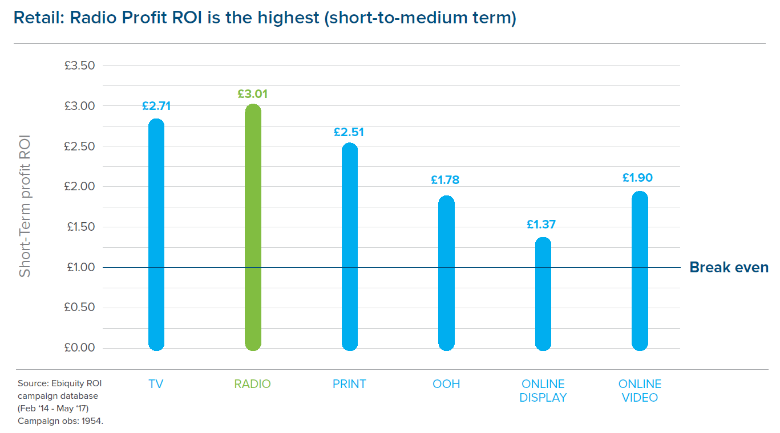
Retail: radio delivers highest profit ROI

Slide 15
Increased radio share = bigger campaign effects
Reallocating budget from TV, press & online to radio increases overall media campaign ROI
+8.5%
Total campaign ROI
Radio % share of campaign spend
Source: ‘Radio: the ROI Multiplier’ from Radiocentre/Holmes & Cook Base: 132 cases with overall campaign ROI data

Slide 16
Rescue Remedy
How radio can help an advertiser’s business during the current crisis
1. Benefit from increased audience availability
2. Make the case for increased investment
3. Re-evaluate the media mix
4. Keep an eye on the longer term

Slide 17
Activation needs brand for optimum effects
Number of very large business effects
Source: Effectiveness in Context/Binet & Field

Slide 18

Radio boosts both short and longer term ad effects
Average number of very large effects
6.1
4.4
Source: IPA Databank

Slide 19
Rescue Remedy
How radio can help an advertiser’s business during the current crisis
1. Benefit from increased audience availability
2. Make the case for increased investment
3. Re-evaluate the media mix
4. Keep an eye on the longer term

Slide 20



Thank you

