Slide 1




RE-EVALUATING MEDIA

Slide 2

ARE WE BEING SHORT-CHANGED
BY SHORTCUTS?

Slide 3
Heuristics are simple, efficient rules which people often use to form judgments and make decisions.
heuristic
/ˌhjʊ(ə)ˈrɪstɪk/

Slide 4



Heuristics and media decision-making
COMPLEXITY
DATA
SPECIALISATION

Slide 5



Heu-risk-tics?
TV Nation/Ad Nation
Sample of One

Slide 6
Objectives for this study
Understand current perceptions
Identify true strengths of media

Slide 7

RE-EVALUATING MEDIA
HEAD AND HEART

Slide 8


Objectives
Identify the most important attributes for a brand-building campaign
Evaluate how each medium performs against these attributes
  EVIDENCE: secondary research
  PERCEPTION: primary research interviews
RE-EVALUATING MEDIA

Slide 9

What you consider to be the most important attributes of an advertising medium

Slide 10
How we assessed relative importance
Trade-off exercise - MaxDiff
Groups of four attributes
Interviewees forced to select the most and least important attribute from each group
60 different combinations tested
RE-EVALUATING MEDIA

Slide 11

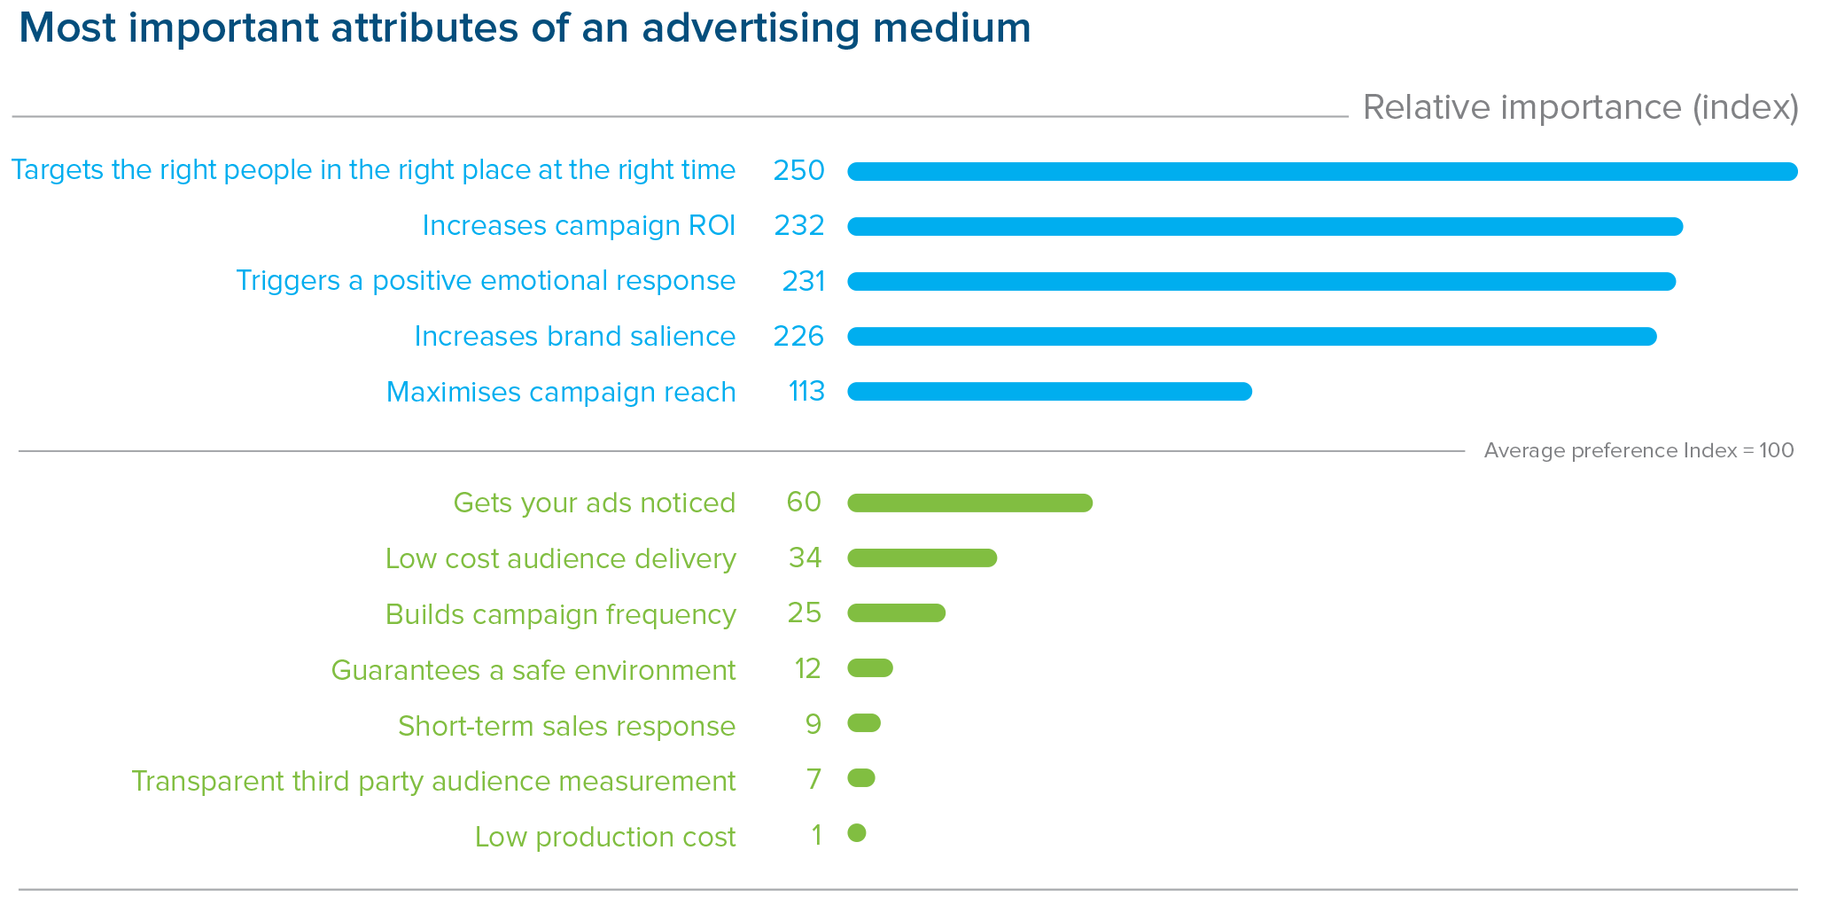
Tight targeting – right people, time & place
Base: All respondents (n=116)
RE-EVALUATING MEDIA

Slide 12
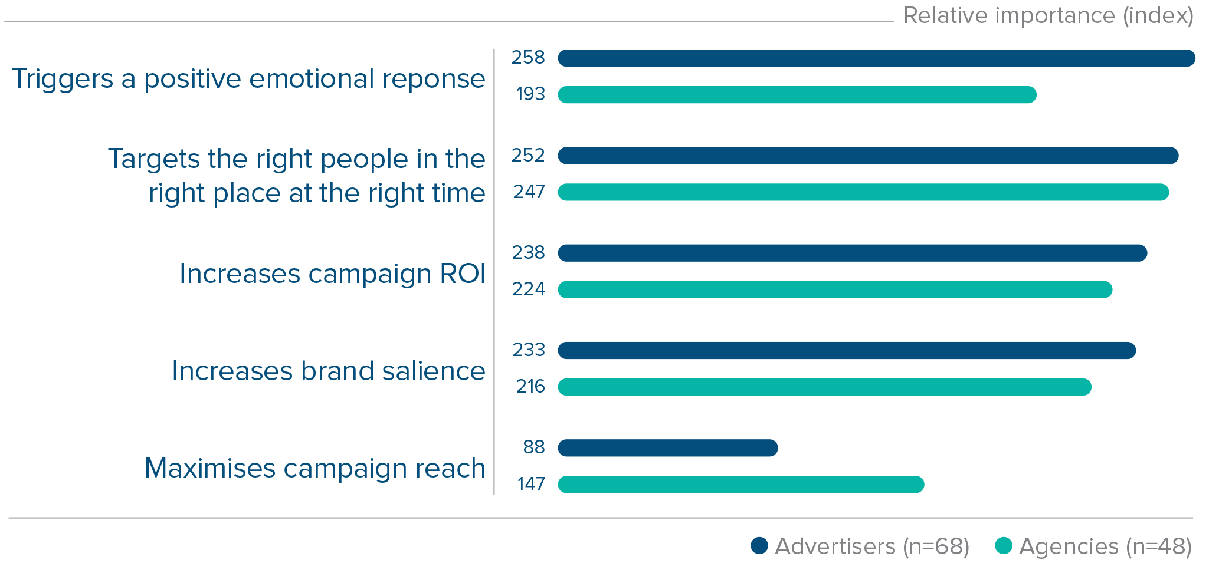
Top scores - advertisers & agencies are aligned
Most important attributes of an advertising medium
RE-EVALUATING MEDIA

Slide 13
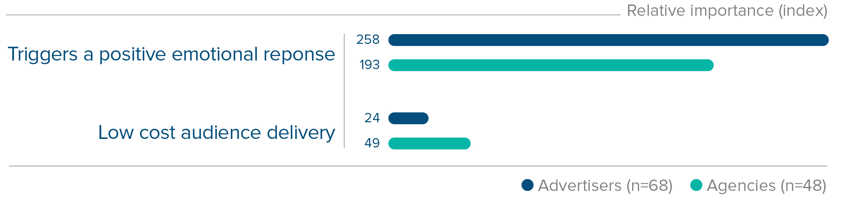
Planning decisions are complex
Experience, instinct and knowledge over cost
Most important attributes of an advertising medium
RE-EVALUATING MEDIA

Slide 14
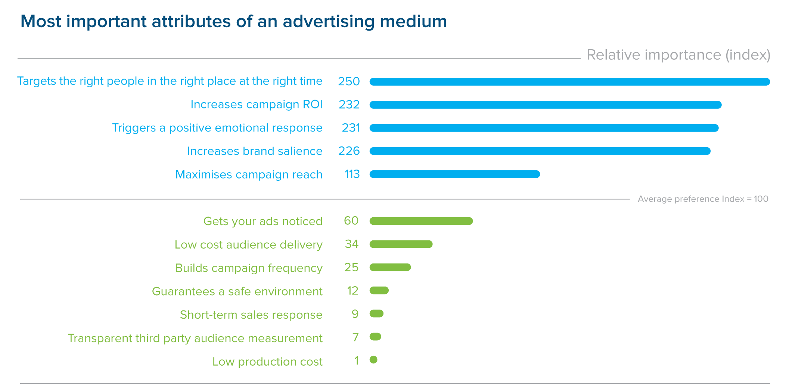
Some of the lower scores are more surprising
Base: All respondents (n=116)
RE-EVALUATING MEDIA

Slide 15
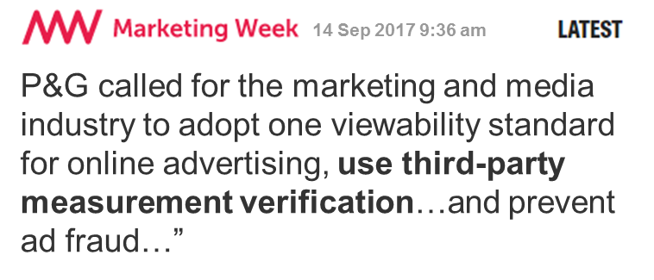
ROI over transparent measurement data
“P&G called for the marketing and media industry to adopt one viewability standard for online advertising, use third-party measurement verification…and prevent ad fraud…”
RE-EVALUATING MEDIA

Slide 16


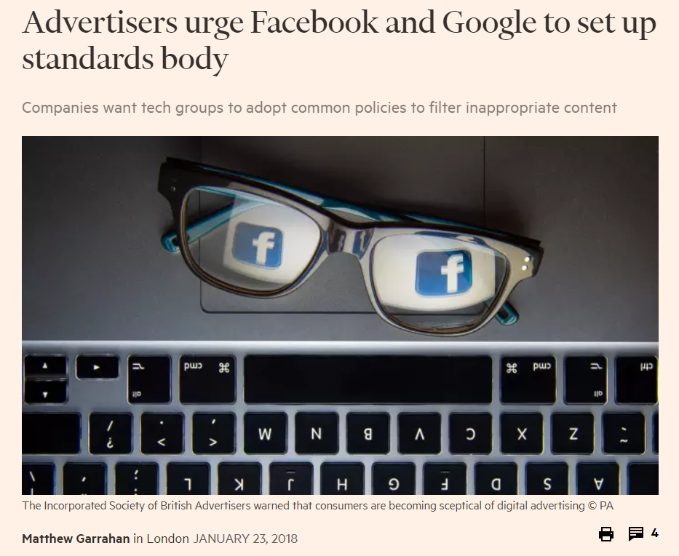
Salience over safety
RE-EVALUATING MEDIA

Slide 17

How does each medium perform against these attributes?

Slide 18
OVERALL PERFORMANCE RANKING
Evidence from data and published studies
What the evidence says
1 | TV | 107.1
2 | Radio | 103.2
3 | Newspapers | 87.8
4 | Magazines | 79.5
5 | Out of home | 71.7
6 | Direct mail | 67.0
7 | Social media | 65.8
8 | Cinema | 61.4
9 | Online video | 57.6
10 | Online display | 50.0
RE-EVALUATING MEDIA

Slide 19
OVERALL PERFORMANCE RANKING
Evidence versus perception
What the evidence says
1 | TV | 107.1
2 | Radio | 103.2
3 | Newspapers | 87.8
4 | Magazines | 79.5
5 | Out of home | 71.7
6 | Direct mail | 67.0
7 | Social media | 65.8
8 | Cinema | 61.4
9 | Online video | 57.6
10 | Online display | 50.0
What advertisers and agencies say
1 | TV | 48.9
2 | Online video | 41.6
3 | Social media | 41.3
4 | Out of home | 39.6
5 | Cinema | 39.1
6 | Radio | 38.9
7= | Newspapers | 36.3
7= | Direct mail | 36.3
9 | Online display | 35.5
10 | Magazines | 35.1
Base: All n=116, each respondent rated 2 attributes
RE-EVALUATING MEDIA

Slide 20
OVERALL PERFORMANCE RANKING
Evidence versus perception
What the evidence says
1 | TV | 107.1
2 | Radio | 103.2
3 | Newspapers | 87.8
4 | Magazines | 79.5
5 | Out of home | 71.7
6 | Direct mail | 67.0
7 | Social media | 65.8
8 | Cinema | 61.4
9 | Online video | 57.6
10 | Online display | 50.0
What advertisers and agencies say
1 | TV | 48.9
2 | Online video | 41.6
3 | Social media | 41.3
4 | Out of home | 39.6
5 | Cinema | 39.1
6 | Radio | 38.9
7= | Newspapers | 36.3
7= | Direct mail | 36.3
9 | Online display | 35.5
10 | Magazines | 35.1
Social Media
“Easy to identify audience and target them. Appears to produce a high level of audience engagement. Reasonably cost effective, but there are issues around accuracy of results.”
Advertiser
Base: All n=116, each respondent rated 2 attributes
RE-EVALUATING MEDIA

Slide 21
OVERALL PERFORMANCE RANKING
Perception leads action
What the evidence says
1 | TV | 107.1
2 | Radio | 103.2
3 | Newspapers | 87.8
4 | Magazines | 79.5
5 | Out of home | 71.7
6 | Direct mail | 67.0
7 | Social media | 65.8
8 | Cinema | 61.4
9 | Online video | 57.6
10 | Online display | 50.0
TV
£5.0bn
DM
£1.7bn
Newspapers
£1.7bn
OOH
£1.1bn
Media expenditure
Mags
£0.6bn
Radio
£0.6bn
Cinema
£0.3bn
Performance rank
Performance rank
RE-EVALUATING MEDIA

Slide 22
OVERALL PERFORMANCE RANKING
Perception leads action
Digital
£5.3bn
What the evidence says
1 | TV | 107.1
2 | Radio | 103.2
3 | Newspapers | 87.8
4 | Magazines | 79.5
5 | Out of home | 71.7
6 | Direct mail | 67.0
7 | Social media | 65.8
8 | Cinema | 61.4
9 | Online video | 57.6
10 | Online display | 50.0
TV
£5.0bn
DM
£1.7bn
Newspapers
£1.7bn
OOH
£1.1bn
Media expenditure
Mags
£0.6bn
Radio
£0.6bn
Cinema
£0.3bn
Performance rank
Performance rank
RE-EVALUATING MEDIA

Slide 23


“Perception is everything, it’s certainty.”
Our perceptions are dictating our decisions
Irrespective of the evidence, irrespective of what consumers feel, say and do
Stephen Colbert
RE-EVALUATING MEDIA

Slide 24

Looking at
individual
attributes

Slide 25
Assessing performance
EVIDENCE - scoring criteria applied and validated by Ebiquity
Straightforward data comparisons
Assessment of structural capabilities
Assessment of published research findings
PERCEPTION - scoring from interviews
RE-EVALUATING MEDIA

Slide 26
Evidence – structural capabilities
TARGETING: REACHING RIGHT PEOPLE, RIGHT PLACE, RIGHT TIME
Geography
Demographics
Day of week
Time of day
Contextual
Addressable
Rated on ability of the medium to target in this way
No = 0
Yes, with limitations = 1
Yes = 2
RE-EVALUATING MEDIA

Slide 27
Top attribute, yet evidence and perception diverge
TARGETING: REACHING RIGHT PEOPLE, RIGHT PLACE, RIGHT TIME
What the evidence says
1 | Radio | 9
2= | Social media | 8
2= | TV | 8
4= | Online display | 7
4= | Cinema | 7
6= | Direct Mail | 6
6= | Out of home | 6
6= | Online video | 6
9 | Newspapers | 5
10 | Magazines | 3
What advertisers and agencies say
1 | Direct mail | 4.0
2 | Social media | 3.9
3= | TV | 3.7
3= | Online video | 3.7
5 | Online display | 3.6
6 | Cinema | 3.2
7= | Out of home | 3.1
7= | Magazines | 3.1
9= | Radio | 3.0
9= | Newspapers | 3.0
Radio
“doesn’t target a very specific, focused audience..”
Advertiser
Base: n=20
RE-EVALUATING MEDIA

Slide 28
Social certainly meets a targeting need
TARGETING: REACHING RIGHT PEOPLE, RIGHT PLACE, RIGHT TIME
What the evidence says
1 | Radio | 9
2= | Social media | 8
2= | TV | 8
4= | Online display | 7
4= | Cinema | 7
6= | Direct Mail | 6
6= | Out of home | 6
6= | Online video | 6
9 | Newspapers | 5
10 | Magazines | 3
What advertisers and agencies say
1 | Direct mail | 4.0
2 | Social media | 3.9
3= | TV | 3.7
3= | Online video | 3.7
5 | Online display | 3.6
6 | Cinema | 3.2
7= | Out of home | 3.1
7= | Magazines | 3.1
9= | Radio | 3.0
9= | Newspapers | 3.0
Social media
“we have the exact data on who we are reaching, their exact age, where they live etc. So we are able to focus our message to them.”
Advertiser
Base: n=20
RE-EVALUATING MEDIA

Slide 29

Digital has reframed our expectations of targeting
TARGETING: REACHING RIGHT PEOPLE, RIGHT PLACE, RIGHT TIME
“We targeted too much, and we went too narrow…and now we’re looking at: what is the best way to get the most reach but also the right precision?”
Mark Pritchard, Chief Marketing Officer, P&G
The Wall Street Journal 17/08/16
RE-EVALUATING MEDIA

Slide 30
RETURN ON INVESTMENT
Evidence based attributes are re-ranked
What the evidence says
1 | TV | 10
2 | Radio | 9
3= | Newspapers | 8
3= | Magazines | 8
5 | Online video | 6
6 | Direct Mail | 5
7 | Social media | 4
8 | Online display | 3
9 | Out of home | 2
10 | Cinema | 1
What advertisers and agencies say
1 | TV | 3.9
2= | Radio | 3.4
2= | Social media | 3.4
2= | Online video | 3.4
5 | Direct mail | 3.3
6 | Out of home | 3.2
7 | Online display | 3.1
8 | Newspapers | 3.0
9 | Magazines | 2.9
10 | Cinema | 2.5
Newspapers
“For most audiences it’s a declining channel…”
Advertiser
Base: n=19
RE-EVALUATING MEDIA

Slide 31
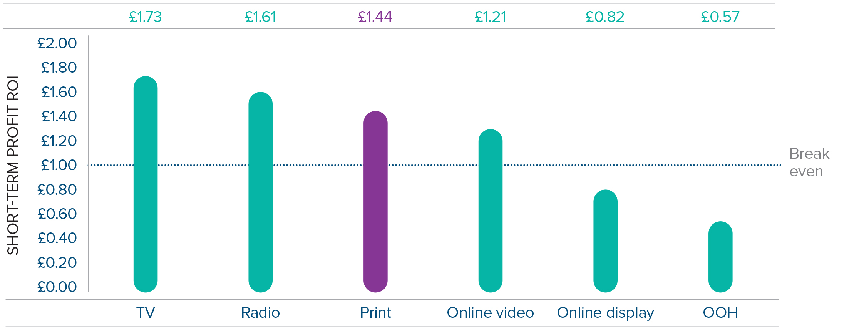
RETURN ON INVESTMENT
Inconsistent in our understanding and interpretation
While online video rightly scores highly, why do we think press doesn’t?
Source: Ebiquity ROI campaign database
RE-EVALUATING MEDIA

Slide 32
Evidence – assessing published research
ABILITY TO TRIGGER A POSITIVE EMOTIONAL RESPONSE
Positive emotional connection
Non-interruptive part of the media experience
CMO Council: How brands annoy fans
DCM: The bigger picture
Magnetic: Moments that Matter
Outsmart: The customer journey
Pearl & Dean: Reel Happiness: Understanding the emotions of cinemagoers
Radiocentre: The emotional multiplier
Radiocentre: Getting vocal
Royal Mail MarketReach: Mail in the home, heart & head
Royal Mail MarketReach: This time it’s personal
Teads: Why people block ads
Thinkbox: Killer charts
Rated on strength of evidence
RE-EVALUATING MEDIA

Slide 33
ABILITY TO TRIGGER A POSITIVE EMOTIONAL RESPONSE
Evidence points to offline media
What the evidence says
1 | Cinema | 10
2= | TV | 9
2= | Radio | 9
2= | Magazines | 9
5= | Newspapers | 8
5= | Out of home | 8
7 | Direct mail | 7
8 | Social Media | 6
9= | Online display | 3
9= | Online video | 3
RE-EVALUATING MEDIA

Slide 34
ABILITY TO TRIGGER A POSITIVE EMOTIONAL RESPONSE
Online climbs from last place to third
What the evidence says
1 | Cinema | 10
2= | TV | 9
2= | Radio | 9
2= | Magazines | 9
5= | Newspapers | 8
5= | Out of home | 8
7 | Direct mail | 7
8 | Social Media | 6
9= | Online display | 3
9= | Online video | 3
What advertisers and agencies say
1 | Cinema | 4.3
2 | TV | 4.1
3 | Online video | 3.7
4 | Radio | 3.4
5= | Social media | 3.1
5= | Magazines | 3.1
7 | Out of home | 2.9
8 | Newspapers | 2.6
9 | Direct mail | 2.4
10 | Online display | 2.3
“People just hate online ads. There's a huge rise in ad blockers and people taking measures to ensure they never even see the ads let alone click on them and engage.”
Full Service agency
Base: n=20
Base: n=20
RE-EVALUATING MEDIA

Slide 35
ABILITY TO TRIGGER A POSITIVE EMOTIONAL RESPONSE
What kind of emotional response are we seeking?
“Consumers revealed that the most annoying digital advertising formats - even on trusted media channels - were intrusive pop-up ads and auto-playing video ads.”
How brands annoy fans, CMO Council 2017
RE-EVALUATING MEDIA
RE-EVALUATING MEDIA

Slide 36
LOW COST AUDIENCE DELIVERY
Even attributes based in fact are reinterpreted
What the evidence says
1 | Radio | 10
2 | Out of home | 9
3 | Newspapers | 8
4 | Social media | 7
5 | Online display | 6
6 | TV | 5
7 | Magazines | 4
8 | Online video | 3
9 | Cinema | 2
10 | Direct mail | 1
RE-EVALUATING MEDIA

Slide 37
LOW COST AUDIENCE DELIVERY
Offline media offer low cost audience delivery, yet…
What the evidence says
1 | Radio | 10
2 | Out of home | 9
3 | Newspapers | 8
4 | Social media | 7
5 | Online display | 6
6 | TV | 5
7 | Magazines | 4
8 | Online video | 3
9 | Cinema | 2
10 | Direct mail | 1
What advertisers and agencies say
1= | Social media | 4.2
1= | Online video | 4.2
1= | Online display | 4.2
4 | TV | 3.6
5 | Radio | 3.5
6 | Newspapers | 3.4
7 | Out of home | 3.1
8 | Direct mail | 3.0
9 | Magazines | 2.8
10 | Cinema | 2.1
RE-EVALUATING MEDIA

Slide 38
LOW COST AUDIENCE DELIVERY
…online media lead in our perceptions
What the evidence says
1 | Radio | 10
2 | Out of home | 9
3 | Newspapers | 8
4 | Social media | 7
5 | Online display | 6
6 | TV | 5
7 | Magazines | 4
8 | Online video | 3
9 | Cinema | 2
10 | Direct mail | 1
What advertisers and agencies say
1= | Social media | 4.2
1= | Online video | 4.2
1= | Online display | 4.2
4 | TV | 3.6
5 | Radio | 3.5
6 | Newspapers | 3.4
7 | Out of home | 3.1
8 | Direct mail | 3.0
9 | Magazines | 2.8
10 | Cinema | 2.1
RE-EVALUATING MEDIA

Slide 39
LOW COST AUDIENCE DELIVERY
Yet these perceptions are inconsistent
Social media
“Just a really cheap way
of getting your message out there en masse.”
Advertiser
“Online video is the
cheapest form of advertising and also has the most transparency.”
Media agency
RE-EVALUATING MEDIA

Slide 40
Evidence – Perception – Action
“PERCEPTION IS EVERYTHING, IT’S CERTAINTY”
There is so much information and data available
Yet we use perceptions and instincts rather than evidence to budget and plan
Consumers and advertisers are paying the price
RE-EVALUATING MEDIA

Slide 41

What the future holds for media

Slide 42
WILL THE SHIFT IN ADVERTISING BUDGETS TO DIGITAL CONTINUE?
Most think budgets will continue to move online
“Digital media are very measurable and our clients want the results of their spend shown – digital is brilliant for this!”
Media agency
“[using] digital formats…It's easier to know what you're getting for your money, attribution tools are telling you a lot… (or are they?)”
Advertiser
Base: n=116
RE-EVALUATING MEDIA

Slide 43
WILL THE SHIFT IN ADVERTISING BUDGETS TO DIGITAL CONTINUE?
But there are signs of a potential correction
“That trend will slow down dramatically due to lack of transparency.”
Media agency
RE-EVALUATING MEDIA

Slide 44
WILL THE SHIFT IN ADVERTISING BUDGETS TO DIGITAL CONTINUE?
But there are signs of a potential correction
“That trend will slow down dramatically due to lack of transparency.”
Media agency
“Questions are being asked with regards to safety, fraud and digital blocking, so I think it will decline somewhat.”
Advertiser
RE-EVALUATING MEDIA

Slide 45
WILL THE SHIFT IN ADVERTISING BUDGETS TO DIGITAL CONTINUE?
But there are signs of a potential correction
“That trend will slow down dramatically due to lack of transparency.”
Media agency
“Questions are being asked with regards to safety, fraud and digital blocking, so I think it will decline somewhat.”
Advertiser
“…issues with ‘businesses marking its own homework’, and measurement provided by interested parties.”
Advertiser
RE-EVALUATING MEDIA

Slide 46
WILL THE SHIFT IN ADVERTISING BUDGETS TO DIGITAL CONTINUE?
But there are signs of a potential correction
“That trend will slow down dramatically due to lack of transparency.”
Media agency
“People are now waking up to
the fact that it's not delivering what it says it is.”
Advertiser
“Questions are being asked with regards to safety, fraud and digital blocking, so I think it will decline somewhat.”
Advertiser
“…issues with ‘businesses marking its own homework’, and measurement provided by interested parties.”
Advertiser
RE-EVALUATING MEDIA

Slide 47

Implications for advertisers

Slide 48
We need to re-evaluate our communications approach
Consumers use the whole range of communications channels intuitively
As comms experts we seem unable to match this
We have to open our minds to data, logic, evidence and imagination
Use our heads as well as our hearts
RE-EVALUATING MEDIA

Slide 49
We need to re-evaluate our communications approach
“Marketing is ultimately about the mix
and the layering of all the touch points
…It is about getting the proportions
right to be most effective.”
Advertiser
RE-EVALUATING MEDIA

Slide 50

Because Kylie Jenner wants her first love back in her life
RE-EVALUATING MEDIA

Slide 51
WHERE NEXT?

Slide 52


Slide 53
TV vs. online video
Compares score for each medium against each attribute
Source: Re-evaluating Media conducted by Ebiquity

Slide 54
Newspapers vs. online display
Compares score for each medium against each attribute
Source: Re-evaluating Media conducted by Ebiquity

Slide 55
Radio vs. social media
Compares score for each medium against each attribute
Source: Re-evaluating Media conducted by Ebiquity

Slide 56
Consider radio more for brand-building campaigns
Digital
£5.3bn
What the evidence says
1 | TV | 107.1
2 | Radio | 103.2
3 | Newspapers | 87.8
4 | Magazines | 79.5
5 | Out of home | 71.7
6 | Direct mail | 67.0
7 | Social media | 65.8
8 | Cinema | 61.4
9 | Online video | 57.6
10 | Online display | 50.0
TV
£5.0bn
DM
£1.7bn
Newspapers
£1.7bn
OOH
£1.1bn
Media expenditure
Mags
£0.6bn
Radio
£0.6bn
Cinema
£0.3bn
Performance rank

Slide 57


Slide 58


Slide 59


Slide 60
RE-EVALUATING MEDIA
What the evidence reveals about
the true worth of media for brand advertisers
Thank you

